Slide 1


ENGR 1111 Intro to Engineering: Civil Engineering Fall 2022 Part 4: Environmental Engineering as a Profession

Slide 2
Part 4: Environmental Engineering as a Profession
Environmental Engineers Make a Difference
Duties and Important Characteristics of Environmental Engineers
Becoming an Environmental Engineer: A Lifelong Process
Problem Solving

Slide 3
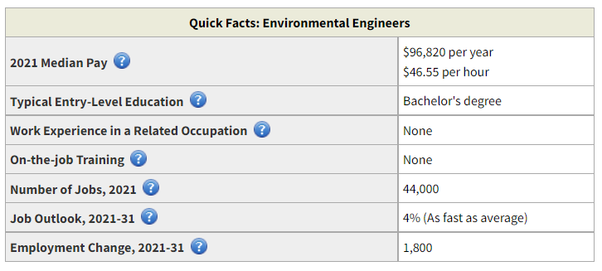
Part 4: Environmental Engineering as a Profession
Jobs in Demand
US Bureau of Labor Statistics
Environmental Engineers : Occupational Outlook Handbook: : U.S. Bureau of Labor Statistics (bls.gov)

Slide 4
Part 4: Environmental Engineering as a Profession
Report Card
Since 1998, the American Society of Civil Engineers (ASCE) has been rating the state of America’s infrastructure
 | 1998 grade | 2005 grade | 2021grade
Drinking water | D | D- | C-
Wastewater | D+ | D- | D+
Solid Waste | C- | C+ | C+
Hazardous Waste | D- | D | D+
https://infrastructurereportcard.org/

Slide 5
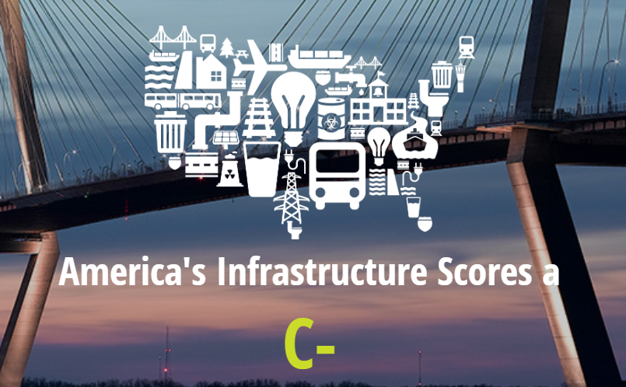
Part 4: Environmental Engineering as a Profession
Challenges
Environmental Engineers are part of the solution!

Slide 6
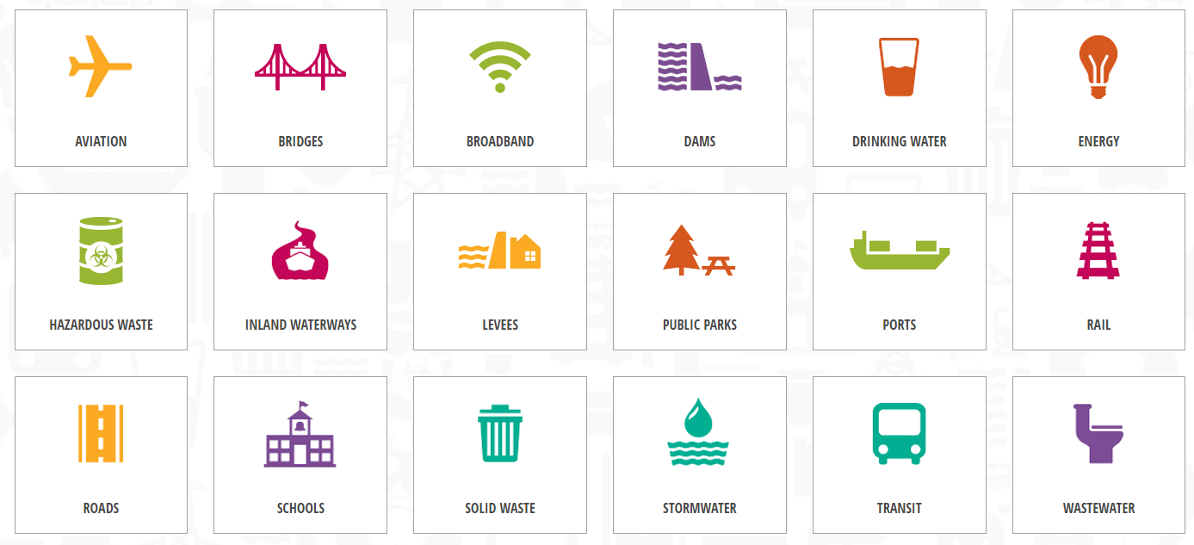
Part 4: Environmental Engineering as a Profession
https://infrastructurereportcard.org/

Slide 7
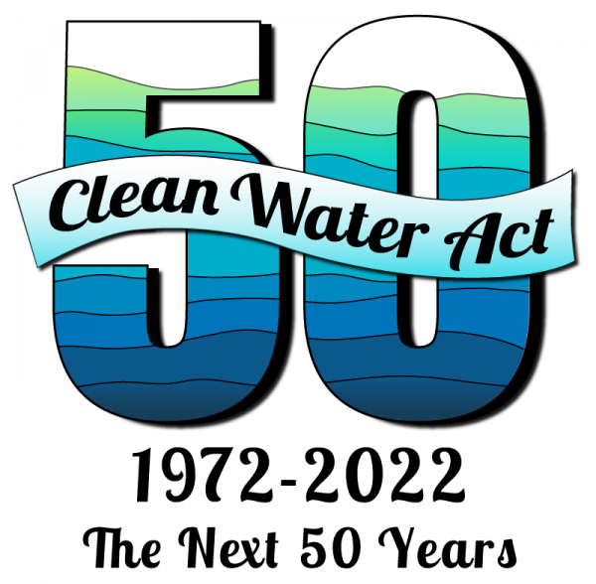
Part 4: Environmental Engineering as a Profession
The Water Infrastructure Network (WIN)
Coalition made up of elected officials, water and wastewater providers, regulators, administrators, engineers, and environmentalists
Projected in 2004 that more than $23 billion will be needed annually to meet Clean Water Act

Slide 8
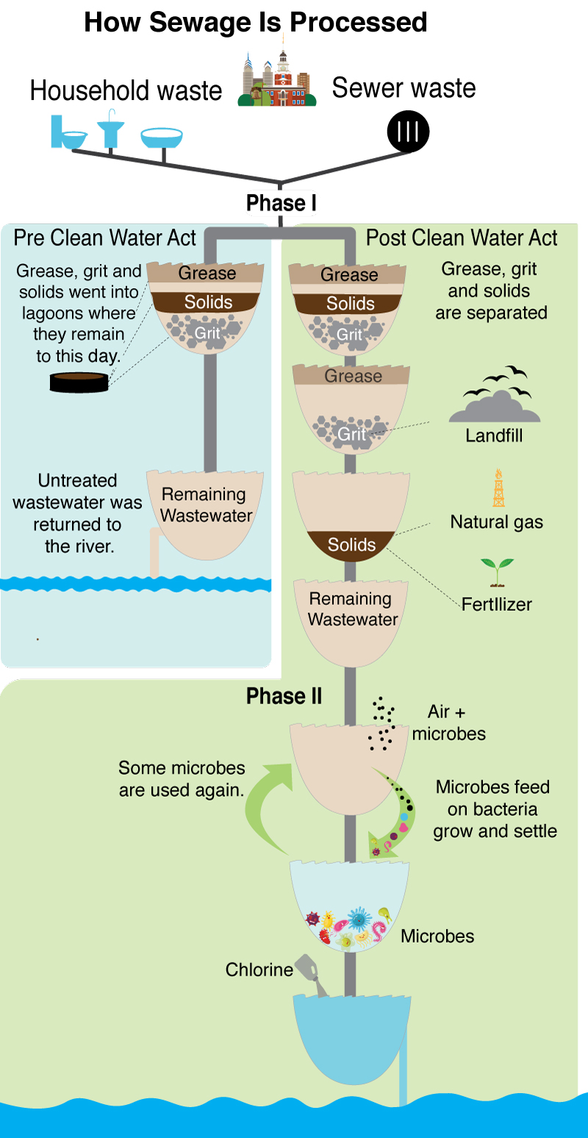
Part 4: Environmental Engineering as a Profession
Federal Water Pollution Control Act (FWPCA), 1948
Amendments in 1972
Clean Water Act, 1977
Primary federal law in the United States governing water pollution
Objective: restore and maintain the chemical, physical and biological integrity of the nation’s waters
Does not address groundwater contamination
Water Quality Act (WQA), 1987

Slide 9
Part 4: Environmental Engineering as a Profession
Basic Necessities – New Challenges
Environmental Engineers are needed for the continuous maintenance of:
high-quality drinking water
clean air
uncontaminated ground and surface water
uncontaminated land

Slide 10
Part 4: Environmental Engineering as a Profession
Basic Necessities – New Challenges
As the world’s population grows, new challenges arise
Greater amounts of waste
More wasteful habits with increase in economic well-being
Modern lifestyles require considerable amounts of energy and resources from the earth that must be treated before being reintroduced into the environment

Slide 11

Part 4: Environmental Engineering as a Profession
Basic Necessities – New Challenges
Antibiotics, anti-inflammatory medicines, hormones, etc. found in water and wastewater

Slide 12
Part 4: Environmental Engineering as a Profession
Duties and Important Characteristics of Environmental Engineers
Multidisciplinary Teams
Work Outdoors
Consulting Firms
Government
Regulatory Agencies
Industry
Academia

Slide 13


Part 4: Environmental Engineering as a Profession
Multidisciplinary Teams
Be a team player!
Engineering disciplines must work together
Good communication skills to convey thoughts to both technical and nontechnical audiences
Written
Oral

Slide 14

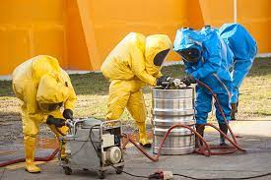
Part 4: Environmental Engineering as a Profession
It is not unusual for environmental engineers to work outdoors
Collection of air, water, and soil samples
Supervising wastewater treatment facilities
Managing or supervising hazardous cleanup
Performing soil surveys, environmental assessments, water-quality surveys

Slide 15
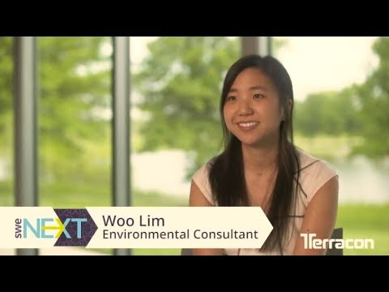

Part 4: Environmental Engineering as a Profession
Consulting Firms
Many environmental engineers work for consulting firms
Focus on technical issues related to the selection and design of technologies to treat water, wastewater, air pollution, groundwater, and contaminated soil
May progress to management or formation of new firms

Slide 16

Part 4: Environmental Engineering as a Profession
Government
City or county governments and municipalities
Oversee the operation of public works departments, engineering departments, water treatment plants and wastewater reclamation facilities
Planning and budgeting of major projects are a prime responsibility

Slide 17
Part 4: Environmental Engineering as a Profession
Regulatory Agencies
Environmental engineers also work at federal and state regulatory agencies
Reviewing and permitting new water and wastewater treatment plants
Air-pollution control technologies
Cleanup of contaminated land sites
Operation of sanitary landfills

Slide 18
Part 4: Environmental Engineering as a Profession
Industry
Environmental Engineers ensure compliance in some industries
Examples:
Pulp and paper manufacturing
Textile processing
Petroleum and petrochemical
Pharmaceutical
Meat processing
Oversee water use or amount of pollutants produced

Slide 19
Part 4: Environmental Engineering as a Profession
Becoming an Engineer: A Lifelong Process
College Education
Professional Licensure
Engineering Ethics
Continuing Education

Slide 20
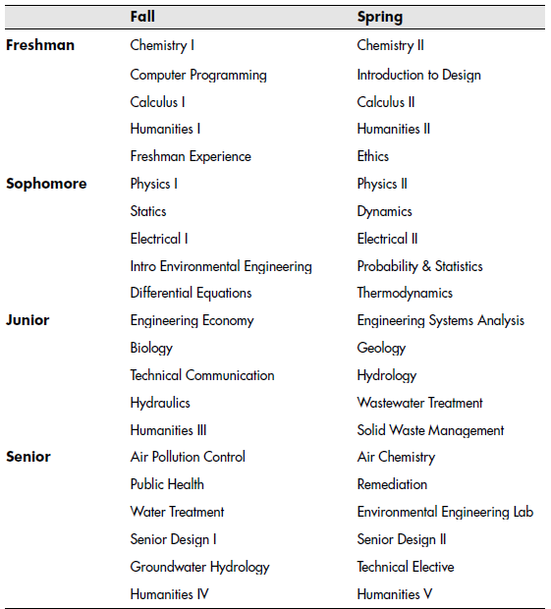
Part 4: Environmental Engineering as a Profession
College Education

Slide 21
Part 4: Environmental Engineering as a Profession
College Education

Slide 22


Part 4: Environmental Engineering as a Profession
Professional Licensure

Slide 23
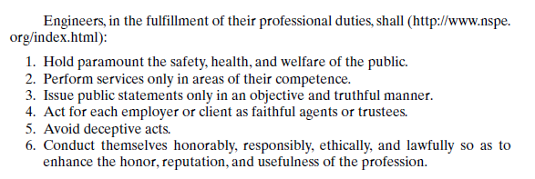
Part 4: Environmental Engineering as a Profession
Becoming an Engineer: A Lifelong Process
Engineering Ethics

Slide 24
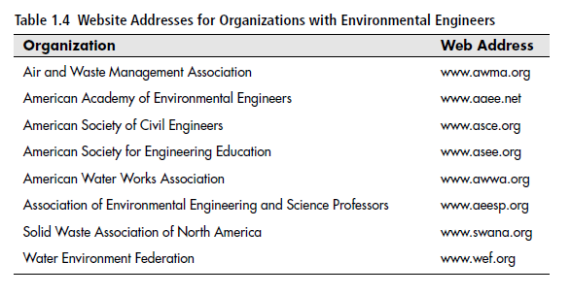
Part 4: Environmental Engineering as a Profession
Becoming an Engineer: A Lifelong Process
Continuing Education

Slide 25
Part 4: Environmental Engineering as a Profession
Problem Solving
Identify and understand the system
Define parameters
Solve the problem
Does it make sense?

Slide 26
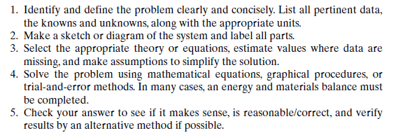
Part 4: Environmental Engineering as a Profession
Problem Solving

Slide 27
ENGR 1111 Intro to Engineering: Civil Engineering Fall 2022 Part 4: Environmental Engineering as a Profession

